Slide 1
Intercultural contact Hypothesis

Slide 2
Contact hypothesis
Contact Hypothesis (Allport, 1954): Under favorable conditions, regular interaction between members of different groups reduces prejudice.
Negative stereotypes arise because groups aren’t in contact often enough with each other.
Contact only works…
Among people of equal status and/or size.
When positive.
When outgroup members are perceived as typical of their group.
Beri, R. (2014). Group, bargaining behaviour & intergroup relations [PowerPoint slides]. SlideShare. https://www.slideshare.net/ruhiberi/group-bargaining-behaviour-intergroup-relations
Notes:
Facilitator notes: Stress to participants that the hypothesis does not assert that when members of different groups are in contact, this automatically improves relations. Rather, certain conditions must be in place so that contact has the potential to be positive.

Slide 3
A method to improve relations
fauxels. Photo of people doing handshakes. Pexels. Retrieved June 16, 2022, from https://www.pexels.com/photo/photo-of-people-doing-handshakes-3183197/

Slide 4
Four CONTACT conditions to reduce prejudice
1. Equal Status and/or Size in a Situation
Members of the contact situation should not have an unequal, hierarchical relationship (e.g., teacher/student, employer/employee).
Both groups should perceive the other to be of equal status and power in the situation (e.g., not members of colonizing and indigenous groups).
Both groups should be of equal size (no majority/minority).
Shimazaki, S. Judgement [sic] scale and gavel in judge office. Pexels. Retrieved June 16, 2022, from https://www.pexels.com/photo/judgement-scale-and-gavel-in-judge-office-5669602/

Slide 5
Four CONTACT conditions to reduce prejudice
2. Common Goals
Members must rely on each other to achieve their shared desired goal.
To bring about effective contact, groups typically need to be making an active effort toward a goal the groups share.
Goals don't need to be identical, as long as both groups perceive that working together will accomplish everyone's goals.
fauxels. Photo of people near wooden table. Pexels. Retrieved June 16, 2022, from https://www.pexels.com/photo/photo-of-people-near-wooden-table-3184418/

Slide 6
Four CONTACT conditions to reduce prejudice
3. Intergroup Cooperation
Members should work together in a non-competitive environment.
The attainment of these common goals must be based on cooperation over competition.
If groups have historically competed for resources or space/borders, cooperation is difficult to achieve.
fauxels. Photo of people touching each other’s hands. Pexels. Retrieved June 16, 2022, https://www.pexels.com/photo/photo-of-people-touching-each-other-s-hands-3184428/
Notes:
Facilitator notes: Emphasize that interaction must be positive and voluntary, and a positive history of interactions must be present as well amongst group members.

Slide 7
Intergroup cooperation: The Robber’s Cave Experiment
In the 1950s, psychologists Muzafer Sherif and Carolyn Wood Sherif asked…
What is it exactly that causes tensions among groups and what can be done to alleviate this tension?
They hypothesized that…
Conflict arises amongst groups when they are forced to compete for limited resources.
They studied…
The behavior of 22 pre-adolescent middle class, Protestant, white boys between 11 and 12 years old in a series of artificial situations at a wilderness camp.
The 22 boys were divided into two groups in separate camps and neither group was told about the existence of the other.

Slide 8
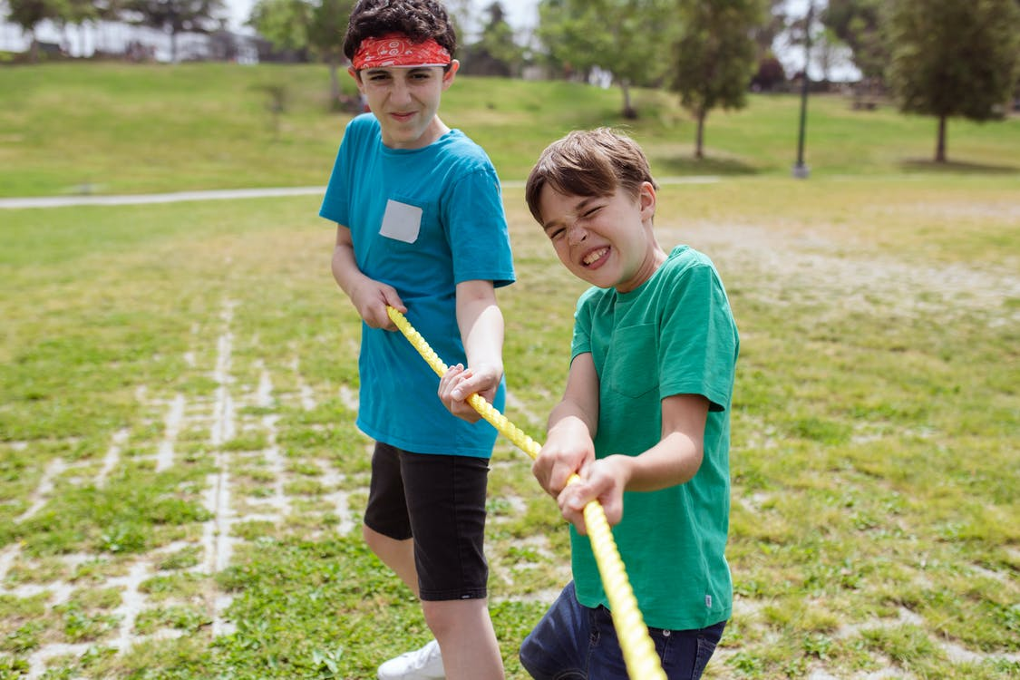
Intergroup cooperation: The Robber’s Cave Experiment
With the two groups separated…
Boys in each camp bonded with one another through shared activities like hiking and swimming.
After one week, the boys in each group had become friends and worked as a team.
Then the two groups met and had to compete against each other for resources…
The competition created tension, name-calling, thievery, vandalism, and violence.
When the winning team was announced, the boys characterized their own team members in positive terms, and the opposite team members in negative terms.
cottonbro. Boys standing on grass field near brown tree. Pexels. Retrieved July 6, 2022,https://www.pexels.com/photo/boys-standing-on-grass-field-near-brown-tree-9292792
RODNAE Productions. Close-up shot of boys playing tug of war on grass. Pexels. Retrieved July 6, 2022, https://www.pexels.com/photo/close-up-shot-of-boys-playing-tug-of-war-on-grass-8034571/

Slide 9
Intergroup cooperation: The Robber’s Cave Experiment
Barriers were created to reach common goals, including…
Fixing broken equipment.
Helping food reach the campsite when it became stranded.
The resolution of such barriers could only be reached through…
Cooperation of both groups.
This intergroup cooperation fostered…
The development of positive interactions between the groups.
Lach, R. Children standing at the seashore while holding signages. Pexels. Retrieved July 6, 2022, https://www.pexels.com/photo/children-standing-at-the-seashore-while-holding-signages-9035241/

Slide 10
Four CONTACT conditions to reduce prejudice
4. Support of Authorities, Law, or Customs
The support of authorities, law, and customs tends to lead to more positive intergroup contact effects because authorities can establish norms of acceptance and guidelines for how group members should interact with each other.
These norms sometimes come with consequences for violating them, which lends accountability for positive group interactions.
This support may also come with incentives, training programs, and other resources that can aid in developing positive contact.
Shimazaki, S. Close–up photo of a wooden gavel. Pexels. Retrieved June 16, 2022, https://www.pexels.com/photo/close-up-photo-of-a-wooden-gavel-5668481/

Slide 11
Recap: Allport’s four contact conditions
Equal Group Status and/or Size
Common Goals
Intergroup Cooperation
Support of Authorities, Law, or Customs
How often do you think all of these contact conditions for positive outcomes are met?

Slide 12
group discussion
Why is establishing equal group status important to achieving common goals?
How could unequal group size create an increased potential for conflict?
How can working toward common goals lead to intergroup cooperation?
What happens when groups have goals, values, or needs that seem to conflict with each other?
How can intergroup cooperation be strengthened by the support of authorities, law, or customs?
How can institutional and societal leaders help reduce prejudice and/or improve relations?
When might these leaders get in the way of positive relations at the grassroots level?

Slide 13
Case study: International students on campus
Purdue University has the 4th highest enrollment of international students amongst U.S. universities and colleges, with students and faculty representing 128 different nations (Purdue University).
Let’s apply Allport’s Contact Conditions to this context…
Equal Group Status and/or Size
What factors impact equality of group status and size in this situation?
Common Goals
How might goals be shared in this situation? How might they be different?
Intergroup Cooperation
Where might competition arise?
What factors or actions could help create a more non-competitive environment?
Support of Authorities, Law, or Customs
What type of support does your university/community/etc. offer?
How might national politics affect international students’ status?
How could leaders and lawmakers show up to take steps to create norms, guidelines,
and frameworks that support International students?
Purdue University. (n.d.). International students and scholars. Retrieved July 6, 2022, from https://www.purdue.edu/IPPU/ISS/
Notes:
Facilitator notes: Factors that impact group status and/or size could include immigration/visa status, minority status, difference in tuition fees required, percentage of International vs. domestic students, etc. A factor that might complicate the achievement of common goals could be that many domestic students can begin building career networks prior to entering university, while International students may only begin when they arrive for their degree program. Encourage students to consider how the structure of a university (siloed vs centralized offices/support/collaboration amongst offices/dorms and dorm locations, etc.) might impact International and domestic student contact (for better or for worse). Another potential topic to bring up: how might domestic students’ high school experiences set them up for success/failure when interacting with International students?

Slide 14
Case Study: women in Stem
Women make up about half the workforce, but only about a quarter of employees in STEM (Carlton, 2021).
Let’s apply Allport’s Contact Conditions to this context…
Equal Group Status and/or Size
How might the status of women (felt, perceived, etc.) come into play in the classroom context? In the workplace?
How might the percentage of women in STEM impact positive contact and reduced prejudice?
Common Goals
How might goals be shared in this situation? How might they be different?
Intergroup Cooperation
Where might competition arise?
What factors or actions could help create a less competitive environment?
Support of Authorities, Law, or Customs
What type of support does your university/community/etc. offer?
How could businesses and lawmakers show up to take steps to support women and increase representation of women in STEM?
How might national politics impact this?
Carlton, G. (2021, November 5). Women in STEM. Best Colleges. Retrieved July 6, 2022, from https://www.bestcolleges.com/resources/women-in-stem

Slide 15
Debrief
Which of the four conditions in Allport’s Contact Conditions do you find the most challenging to meet? Why?
Can you think of a time when you were in contact with a different group where there was unequal status? What were some challenges you faced navigating these dynamics? What was the outcome of the contact?
Can you think of personal examples of establishing common goals? What were they?
Describe an experience of achieving intergroup cooperation.
Give an example of how support of authorities, law, or customs can help resolve intercultural conflicts.

